Slide 1
CARS DATASET
DESCRIPTION:
The given dataset contains details of given car( model, price, cc, etc.) The cars dataset was collected in hope that it has certain influence on the factors determining price of a car. Can also be used to train models to accurately predict prices of models with only a few samples.
CONTENT:
maker - normalized all lowercase
model - normalized all lowercase
mileage - in KM
Manufacture year
Engine displacement - in cc
Engine power - in kW
Body type - almost never present, but I scraped only personal cars, no motorcycles or utility vehicles

Slide 2
Color slug - also almost never present
stk year - year of the last emission control
transmission - automatic or manual
Door count
Seat count
Fuel type - gasoline, Diesel, electric
Date created - when the ad was scraped
Date last seen - when the ad was last seen. Our policy was to remove all ads older than 60 days
Price Eur - list price converted to EUR
REFERENCE:
This dataset was taken from Kaggle :
https://www.kaggle.com/mirosval/personal-cars-classifieds

Slide 3
DATA CLEANING
1.MAKER:
Maker are independent and individual value. So, incase of blank values it is hard to replace.
Removed all the Blank cells using filter in Microsoft Excel.
2. MODEL:
Maker are independent and individual value. So, incase of blank values it is hard to replace.
Removed all the Blank cells using filter in Microsoft Excel.
3. MILEAGE:
We set the minimum value to be 10000 km covered per year and so car with mileage less are removed as erroneous value.
Removed all the Values ( < 10000 ) using filter in Microsoft Excel because mileage should be at least 10000 kms per year.

Slide 4
4. MANUFACTURE YEAR:
This column contained values which are realistically impossible and so it was rectified.
Removed all the Values ( < 1980 ) using filter in Microsoft Excel because car manufacture started at 1980s.
5. ENGINE DISPLACEMENT:
Removed all the Values ( < 1000 ) and ( > 10000 ) using filter in Microsoft Excel because Engine Displacement should be between 1000 and 10000cc.
6. ENGINE POWER:
Removed all the Values ( < 30 ) using filter in Microsoft Excel because Engine Power should not be less than 30kw.
7. BODY TYPE:
This column was almost empty and so I filled it with two categories, namely, SUV and COMPACT with the help of Seat Count using Microsoft Excel.
Formula: =IF(J2>6,"SUV","COMPACT")
Also, renamed the column to Car Type.

Slide 5
8. COLOR SLUG:
Deleted this Column using Microsoft Excel because its of no use.
9. DOOR COUNT:
Deleted this Column using Microsoft Excel because its of no use.
10. STK CONTROL:
Renamed this into Pollution Test.
Categorized the value into TRUE OR FALSE by using IF and Look Up Table formula in Microsoft Excel.
Formula: =IF(all_anonymized_2015_11_2017_03!I2="None", FALSE, TRUE)
11. TRANSMISSION:
Renamed this into Auto Facility.
Categorized the value into TRUE OR FALSE by using IF and Look Up Table formula in Microsoft Excel.
Formula: =IF(all_anonymized_2015_11_2017_03!J2="auto", TRUE, FALSE)

Slide 6
12. SEAT COUNT:
Deleted this Column using Microsoft Excel because its of no use.
13. FUEL TYPE:
Didn’t modify any Values in this column.
14. DATE CREATED:
Deleted this Column using Microsoft Excel because its of no use.
15. DATE LAST SEEN:
Deleted this Column using Microsoft Excel because its of no use.
16. PRICE EUR:
Renamed this column into Price.
This value had many up and down values and so, I took average of every individual car model and replaced by using IF and Look Like Table.
Formula: =IF(O2="X",VLOOKUP(F2,Sheet5!$A$2:$B$27,2,TRUE),N2)

Slide 7
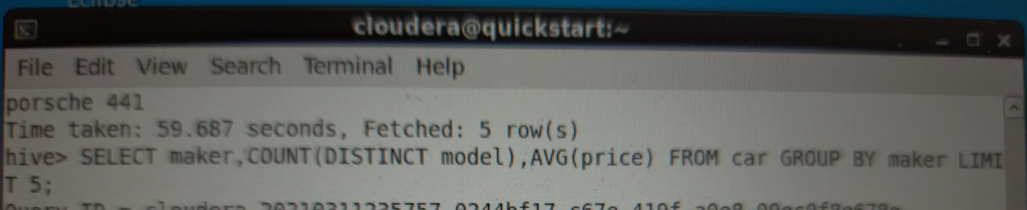
DATA ANALYSIS
QUESTIONS:
1.What is the relationship between car makes, models and price?
QUERY-1
SELECT maker, COUNT(DISTINCT model), AVG(price) FROM car GROUP BY maker LIMIT 5;

Slide 8
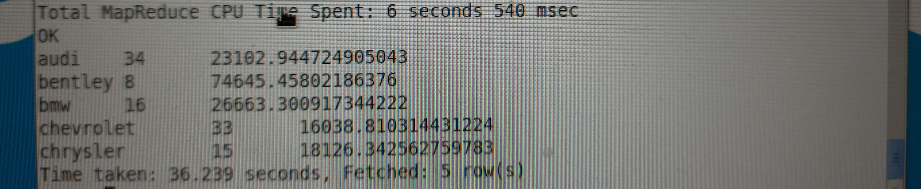
OUTPUT:
audi 34 23102.944724905043
bentley 8 74645.45802186376
bmw 16 26663.300917344222
chevrolet 33 16038.810314431224
chrysler 15 18126.342562759783

Slide 9
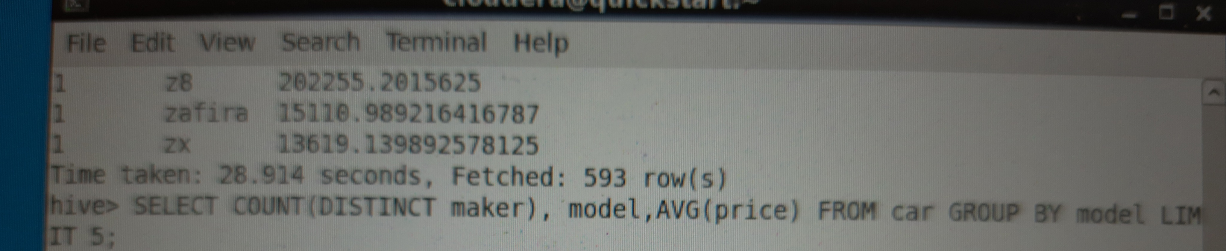
QUERY-2:
SELECT COUNT(DISTINCT maker), model, AVG(price) FROM car GROUP BY model LIMIT 5;

Slide 10
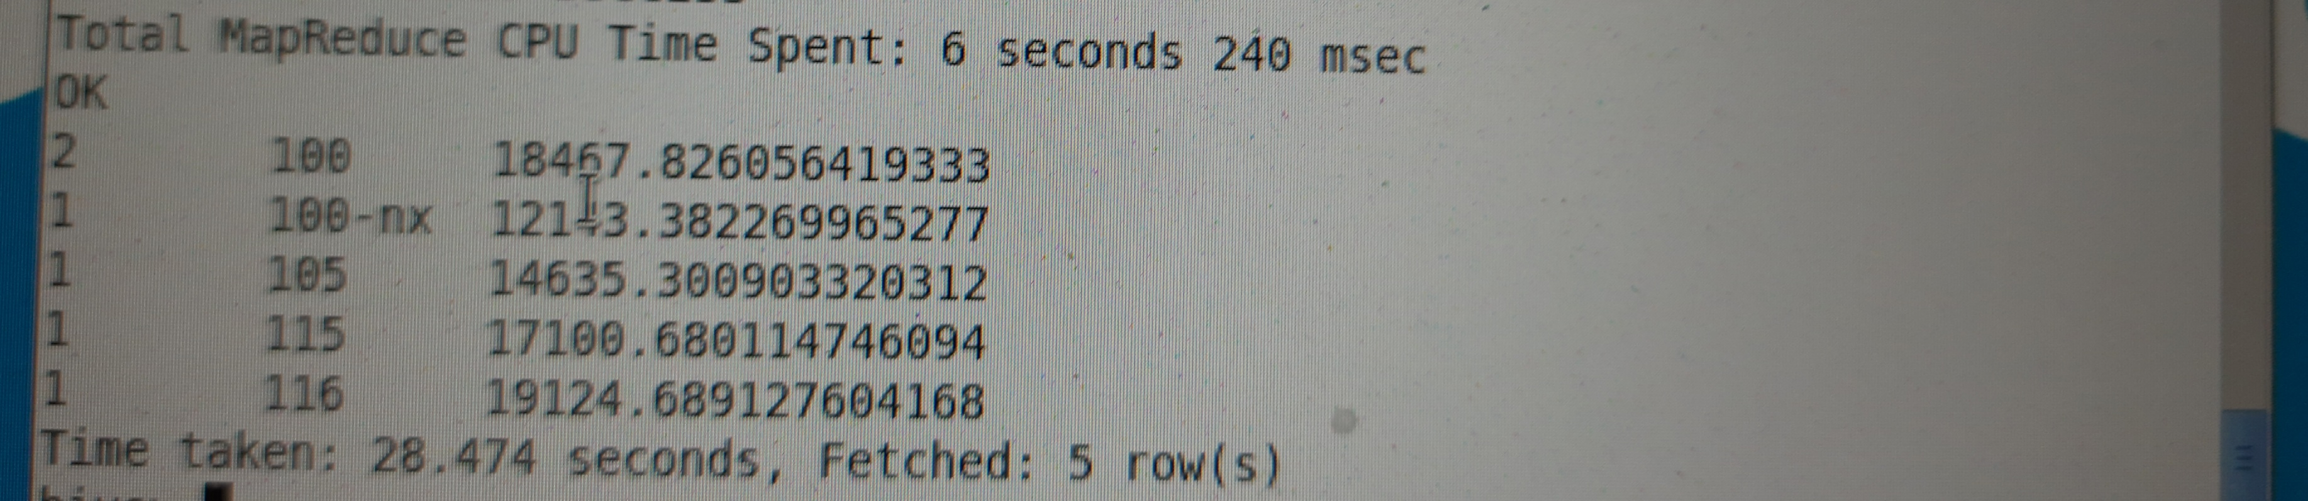
OUTPUT:
2 100 18467.826056419333
1 100-nx 12143.382269965277
1 105 14635.300903320312
1 115 17100.680114746094
1 116 19124.689127604168

Slide 11
JUSTIFICATION FOR QUESTION- 1
ALL THREE COLUMNS,NAMELY, MAKER,MODEL AND PRICE ARE INTERDEPENDABLE BECAUSE PRICE IS DEPENDENT ON MODEL AND MODEL IS DEPENDENT ON MAKER.

Slide 12
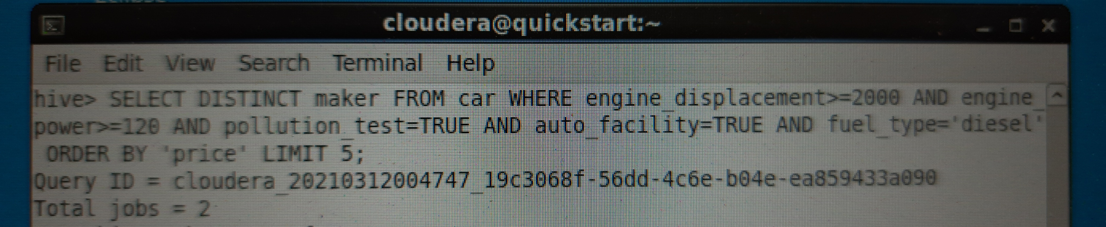
2.What are the top five vehicle manufacturers would you recommend? Why?
QUERY:
SELECT DISTINCT maker FROM car WHERE engine_displacement >= 2000 AND engine_power >= 120 AND pollution_test=TRUE AND auto_facility = TRUE AND fuel_type = 'diesel' ORDER BY 'price' LIMIT 5;

Slide 13
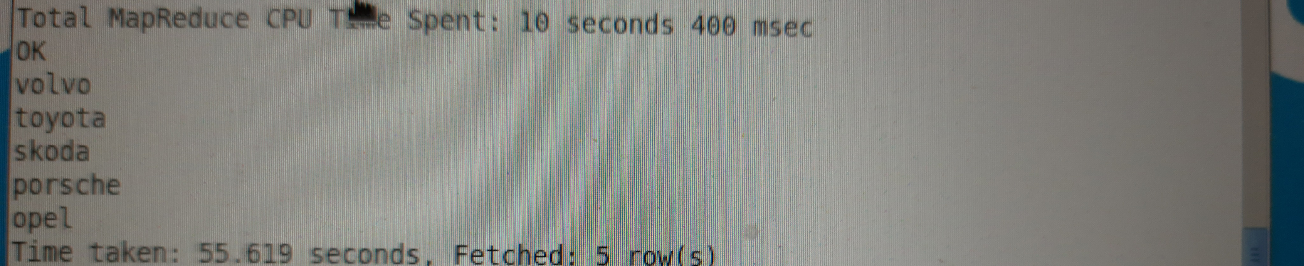
OUTPUT:
volvo
toyota
skoda
porsche
opel

Slide 14
JUSTIFICATION FOR QUESTION- 2
THE TOP 5 MANUFACTURERS ARE LISTED ABOVE . AND IT IS CALCULATED ON THE AVERAGE ENGINE DISPLACEMENT, AVERAGE ENGINE POWER, POLLUTION TEST CERTIFIED, AUTO FACILITY AND FUEL TYPE. FINALLY, PRICE IS CALCULATED ON THE CHEAPEST FIRST BASIS.

Slide 15
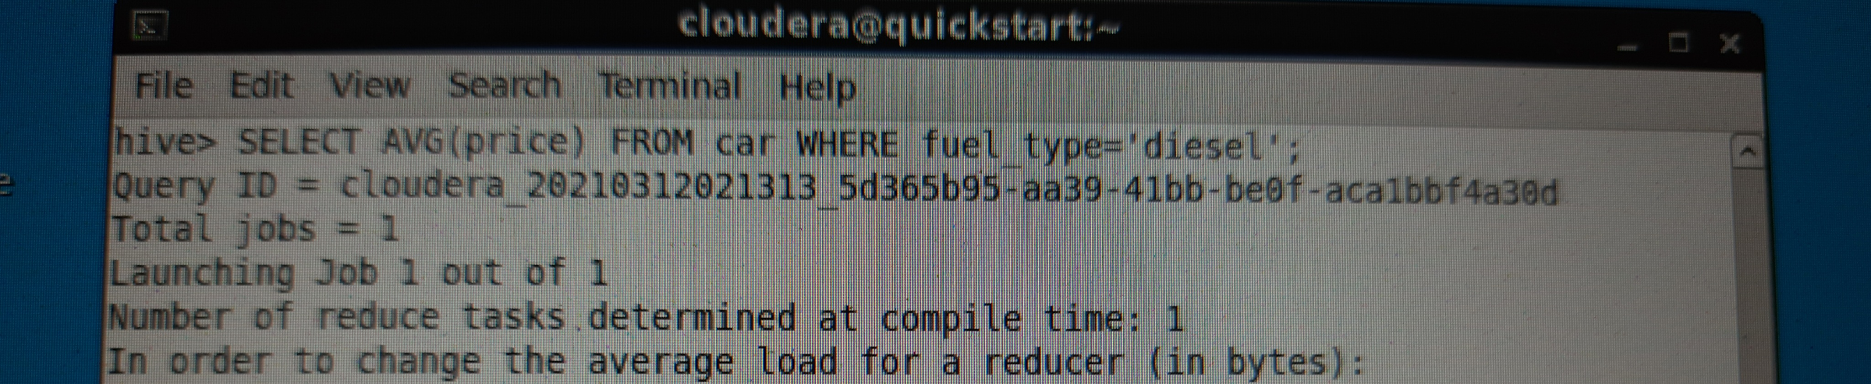

3.Does fuel type have any impact on the car price? Explain
QUERY - 1:
SELECT AVG(price) FROM car WHERE fuel_type='diesel';
OUTPUT:
18084.16866081365

Slide 16
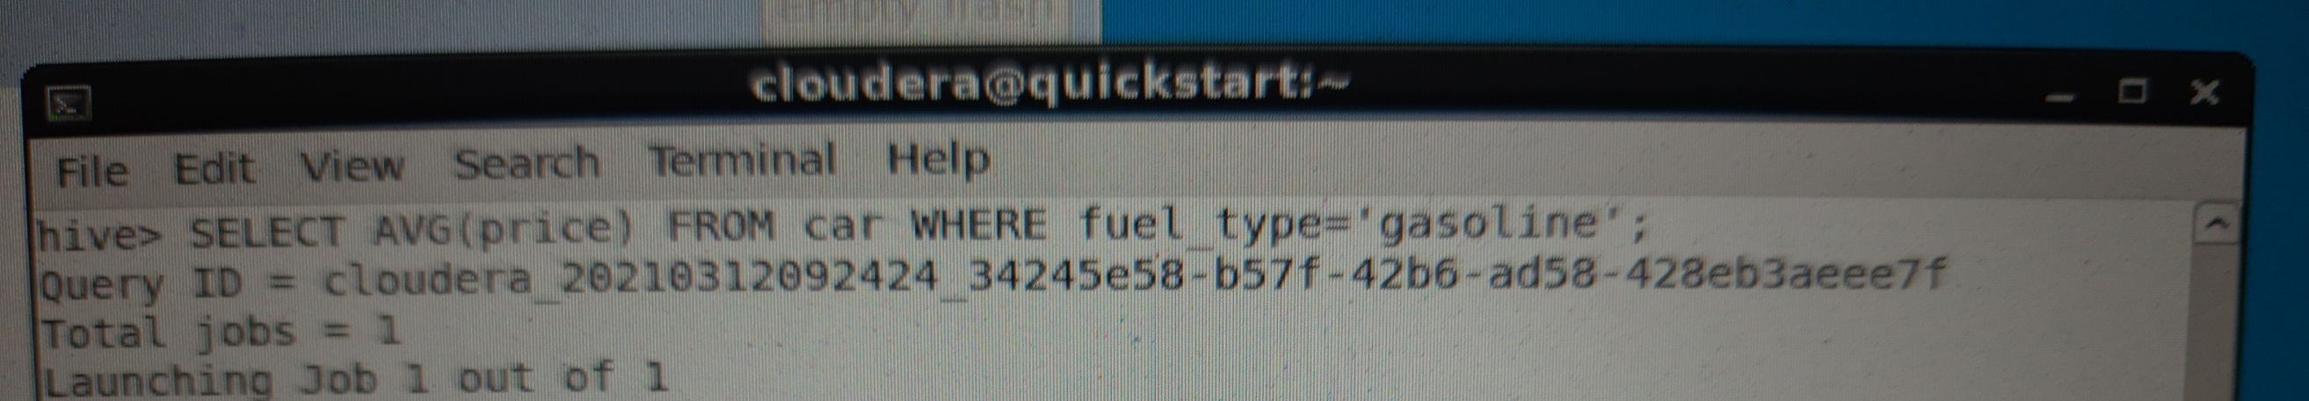

QUERY-2:
SELECT AVG(price) FROM car WHERE fuel_type='gasoline';
OUTPUT:
16773.945271466157

Slide 17
JUSTIFICATION FOR QUESTION- 3
THE AVERAGE PRICE OF DIESEL ENGINE IS 18084.16866081365. AND THE AVERAGE PRICE OF GASOLINE ENGINE IS 16773.945271466157. THE DIFFERENCE IS ABOUT 1311 AND SO THE FUEL TYPE HAVE IMPACT ON THE CAR PRICE.

Slide 18
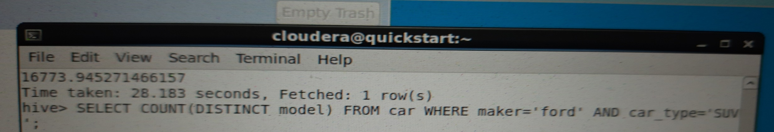
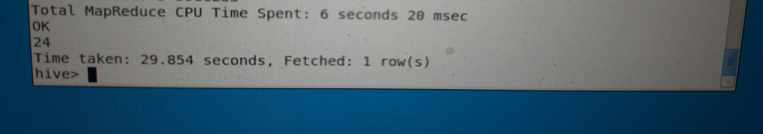
4.How many SUV models did FORD maker launched till now ?
QUERY:
SELECT COUNT(DISTINCT model) FROM car WHERE maker='ford' AND car_type = 'SUV’;
OUTPUT:
24

Slide 19
JUSTIFICATION FOR QUESTION- 4
THE FORD MAKER LAUNCHED 24 SUV CARS TILL NOW.

Slide 20
5. Which 5 car makers have top engine power and passed pollution test ?
QUERY:
SELECT DISTINCT maker,engine_power FROM car WHERE pollution_test=TRUE ORDER BY engine_power DESC LIMIT 5;
OUTPUT:
hyundai 812
audi 516
bentley 460
toyata 449
porsche 441

Slide 21
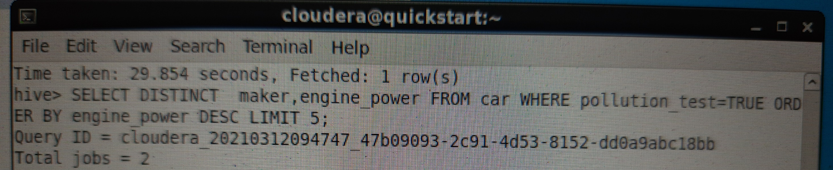
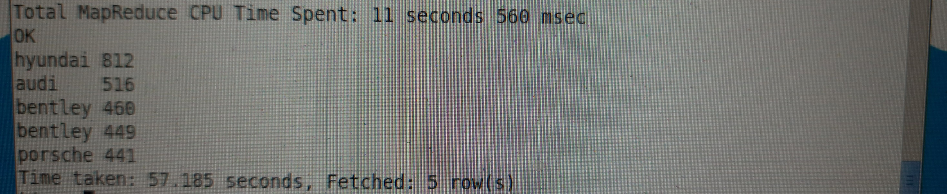

Slide 22
JUSTIFICATION FOR QUESTION- 5
THE BEST 5 CAR MAKERS WHO HAVE TOP ENGINE POWER AND PASSED POLLUTION TEST ARE, NAMELY, HYUNDAI, AUDI, BENTLEY, PORSCHE.

Slide 23
REPORT
From this report, I conclude, the top 5 CAR MANUFACTURERS are
1.Volvo
2.Toyota
3.Skoda
4.Porsche
5.Opel
Above Car Manufacturers are arranged on the below given Rank Basis,
1.Lowest Price
2.Engine Displacement greater than or equal to 2000 cc.
3.Engine Power greater than or equal to 120 kw.
4.Should have passed Pollution emission control test.
5.Should have Automatic Gear facility.
6. Should run in Diesel type engine.

Slide 24
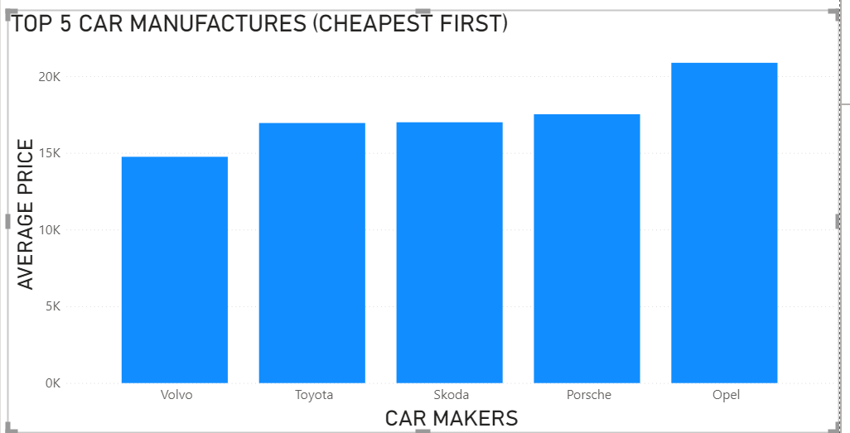
DATA VISUALIZATION

